Slide 1
Models for Understanding and Controlling Global Infectious Diseases HUMBIO 154D / HRP 204
Session 10
Jason Andrews
Jeremy Goldhaber-Fiebert
2020

Slide 2
Course Roadmap
First Models
SIR models with demography
Reproductive Number, Thresholds, Equilibria
Lab: Dynamic Models in R
Heterogeneous mixing and temporal modeling
Emerging infections: takeoff, growth, extinction
Lab: Emerging infections
Vectors, zoonoses, & environmental transmission
Stochastic dynamics
Spatial models, networks
Interventions and sensitivity analyses
Lab: Interventions and sensitivity analyses
Competition and evolutionary models
Within host evolution
Lab on Parameterization, calibration, and uncertainty
Health policy and economic evaluation models
Uses and abuses of models

Slide 3
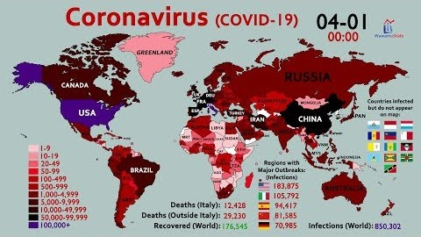
Geographic spread of COVID19
https://youtu.be/J1pPytSRe-s

Slide 4
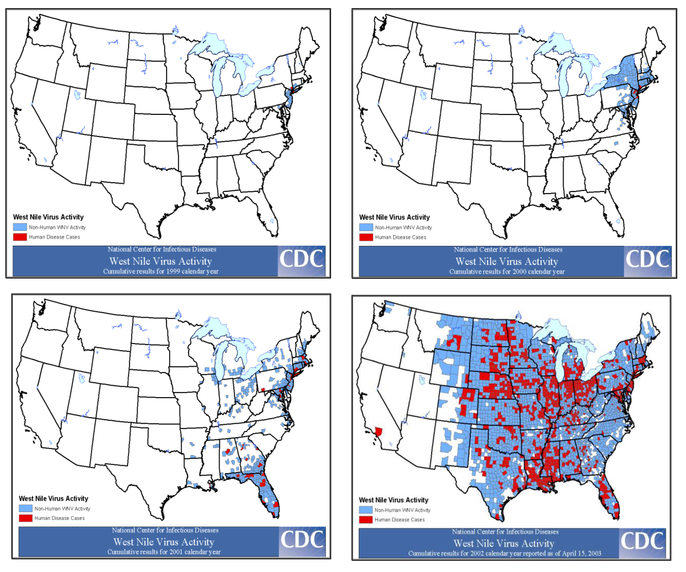

Slide 5

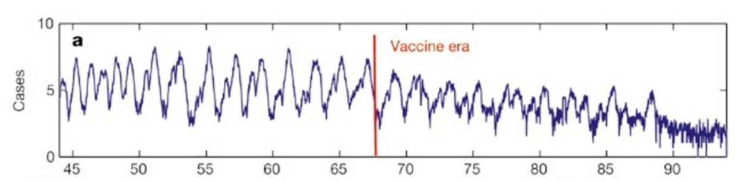
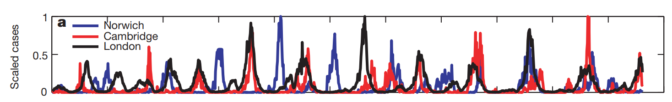
Measles

Slide 6
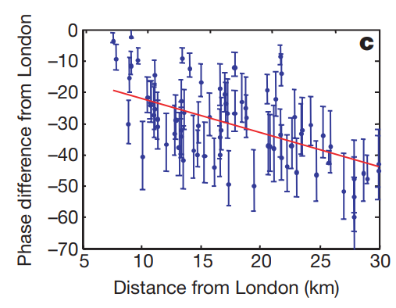
Measles

Slide 7
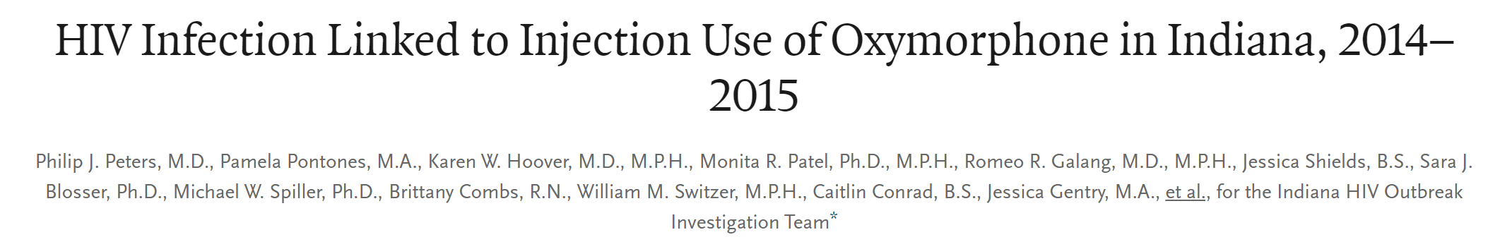

Slide 8
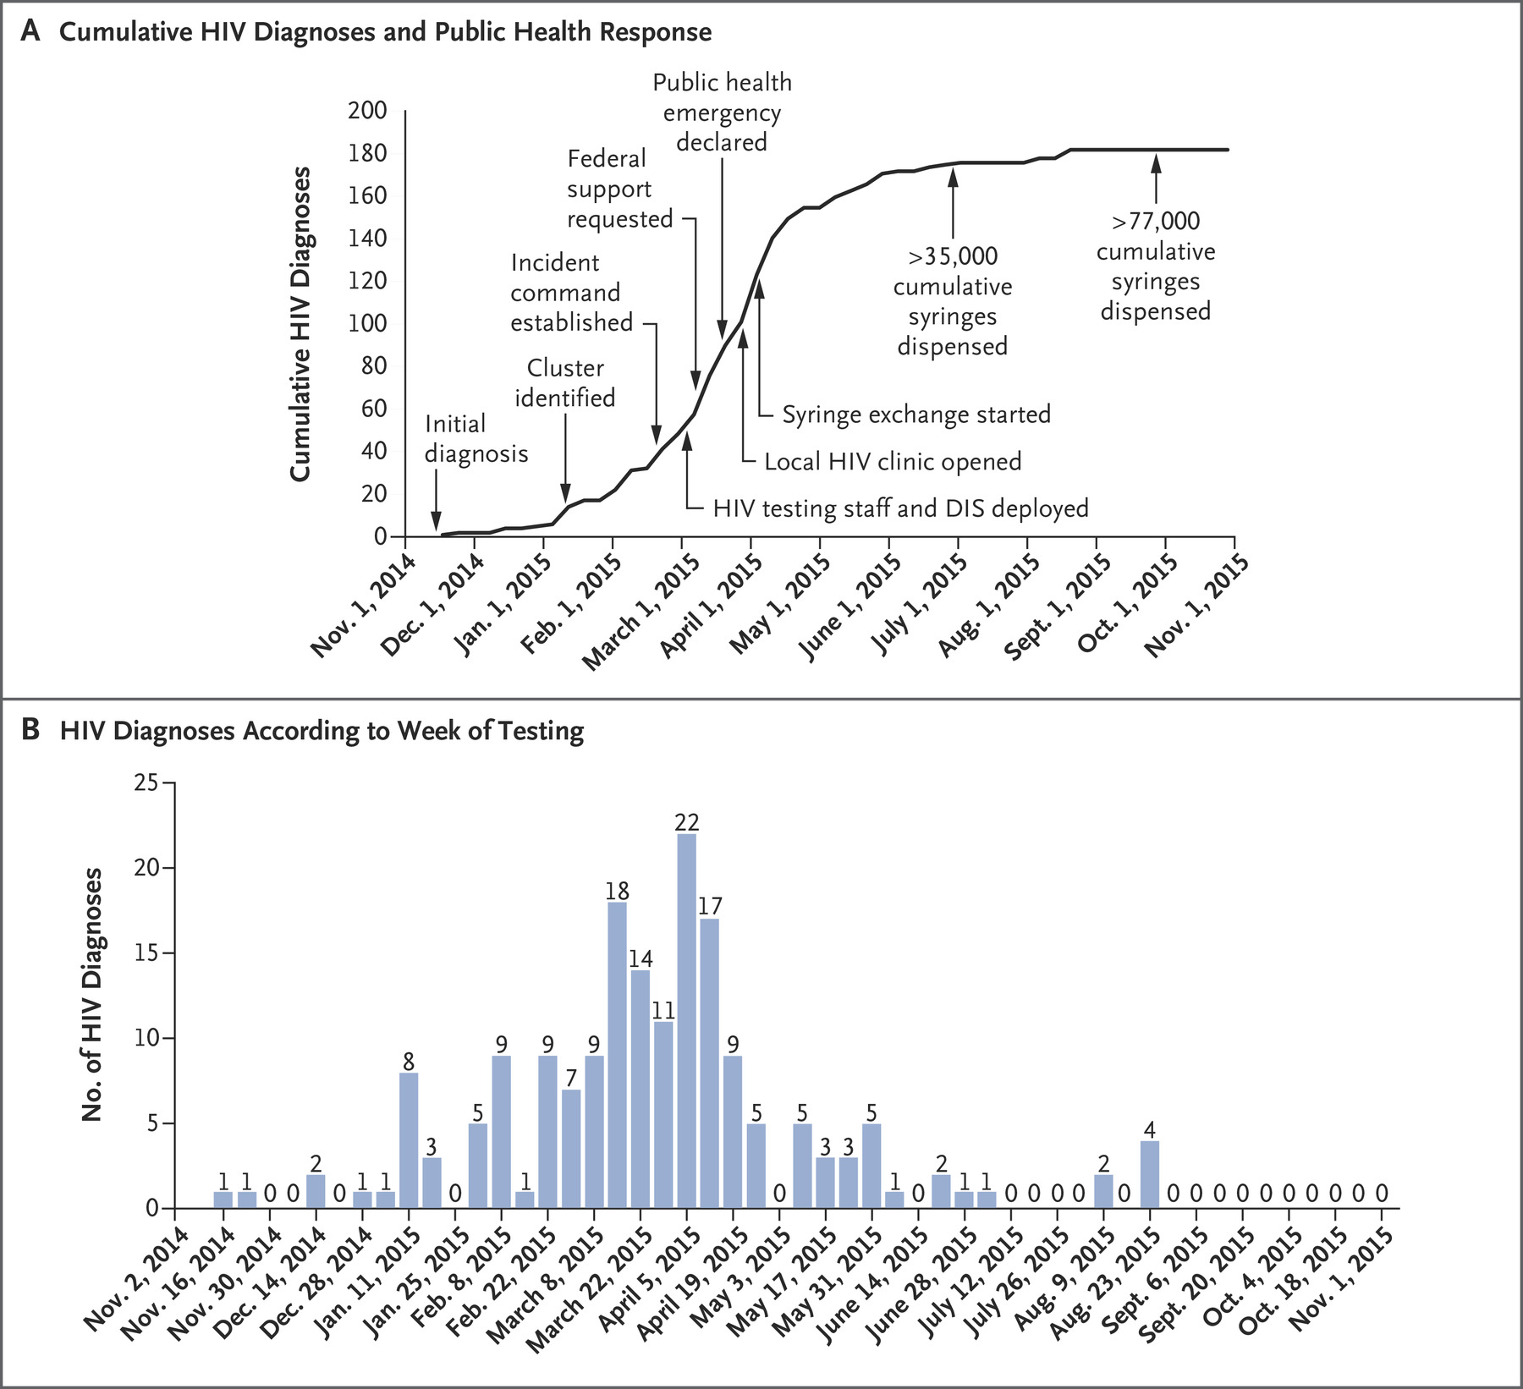

Slide 9
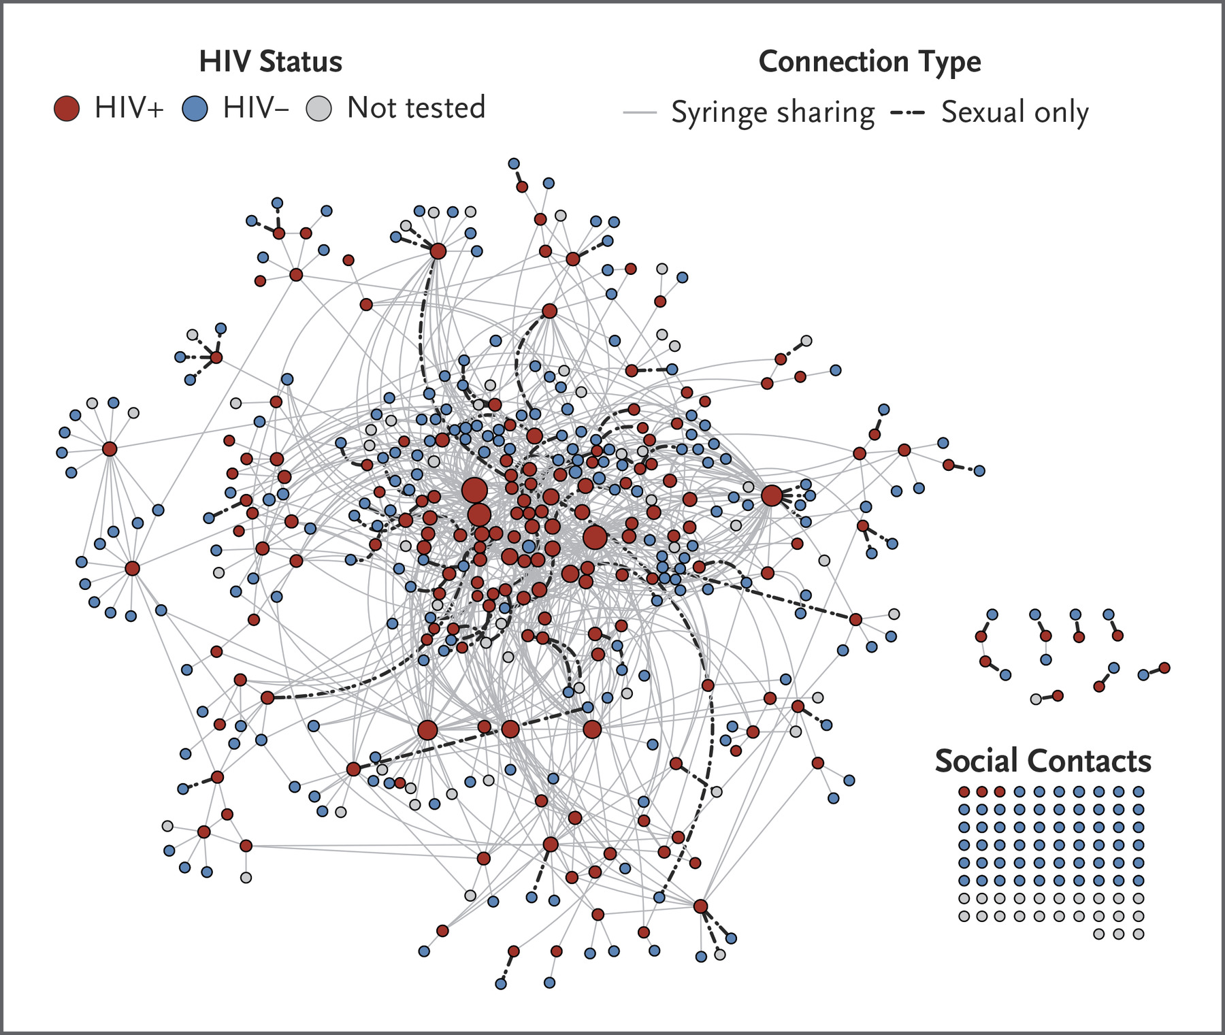

Slide 10
Practical Questions
How does geographic and spatial structure influence the spread of infectious diseases?
How does social network influence the spread of infectious diseases? For which diseases is such structure most relevant?

Slide 11
Learning Objectives
Define what a spatial model is
Define what a meta-population model is
Define what a lattice model is
Describe the use of a transmission kernel
Explain coupling, correlation, synchrony
Describe the relationship of coupling and synchrony to extinction and reimportation
Describe micro- and macro-features of network models (and their various types)
Identify when spatial models are useful/relevant

Slide 12
SPATIAL MODELS (ANOTHER FORM OF HETEROGENEITY) and meta-population models

Slide 13
We have already seen the basic machinery we need for half the lecture today
S₁
I₁
R₁
βI
γ
S₂
βI
I₂
γ
R₁
Instead of thinking about heterogeneous risk groups mixing, we can think about members of 2 different geographic communities mixing
If the communities do not otherwise differ, the more often/strongly they mix, the more the model becomes coupled (synchrony) (pg. 246 describes the typical pattern – sigmoidal in interaction strength)

Slide 14
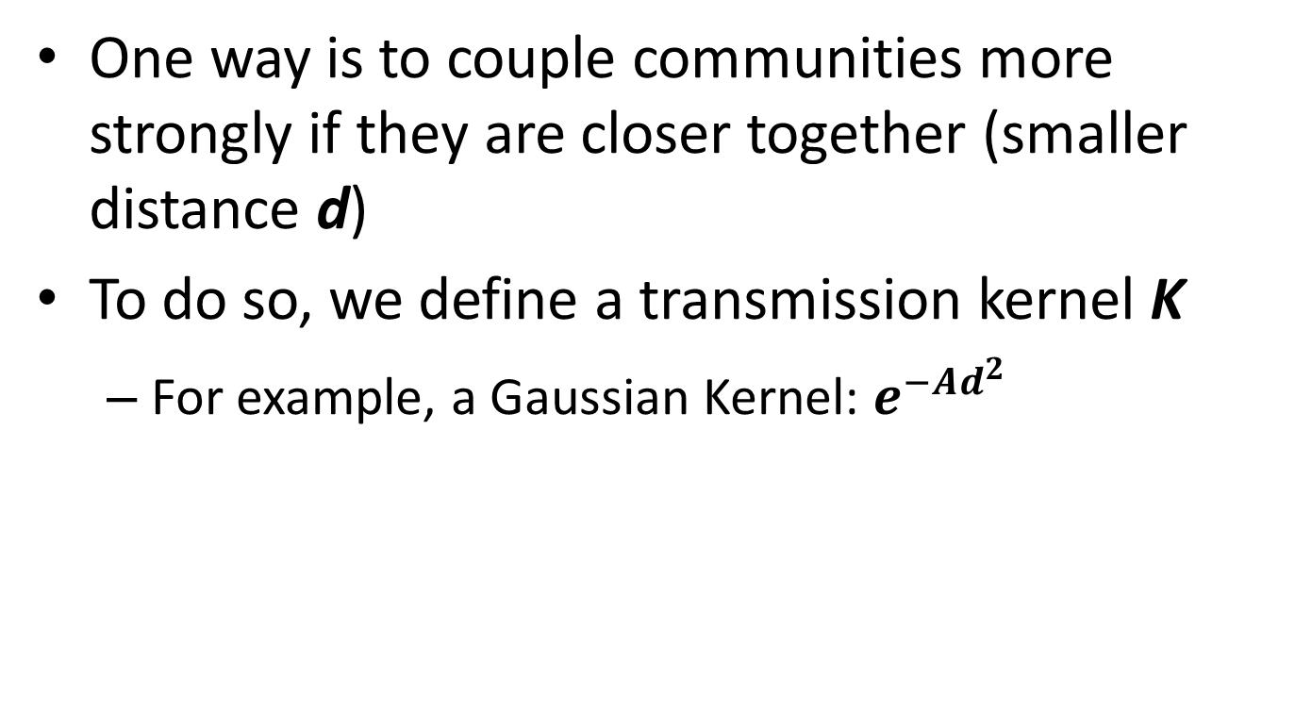
How do we describe the strength of interaction between two communities
One way is to couple communities more strongly if they are closer together (smaller distance d)
To do so, we define a transmission kernel K
For example, a Gaussian Kernel: $e^{−Ad^{2}}$

Slide 15
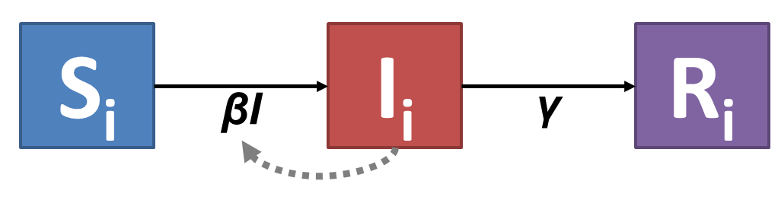
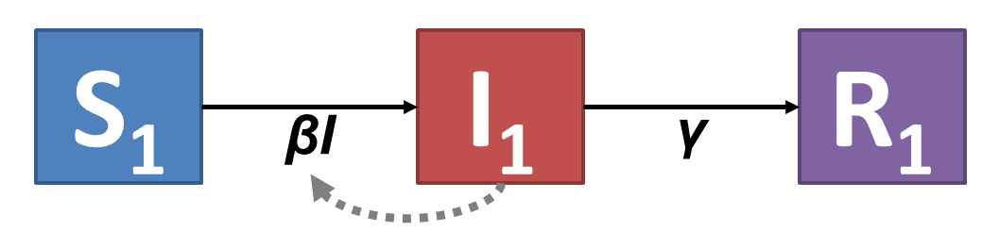
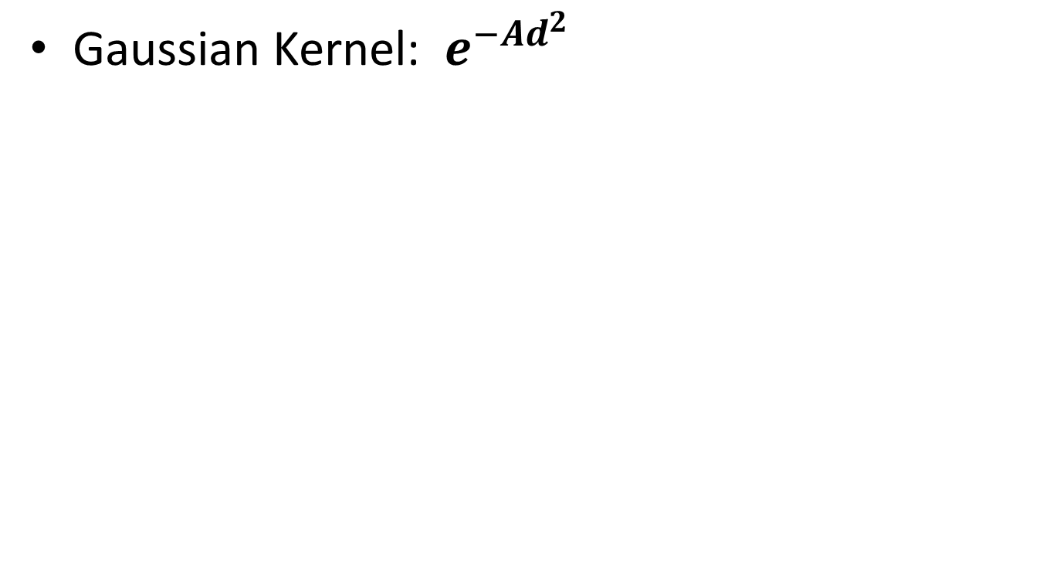
Gaussian Transmission Kernel Example
Gaussian Kernel: $e^{−Ad^{2}}$
Scaling Factor
The interaction between two communities that are farther apart is weaker as it is multiplied by a smaller number from the kernel
1
0
Distance

Slide 16
Size of communities modeled
As we break down our population into more communities, their average size is smaller
This means that local extinction becomes more likely, except …
Coupling between these smaller and smaller communities generally plays a bigger and bigger role and so reimportation plays a more and more important role maintaining infectious prevalence

Slide 17
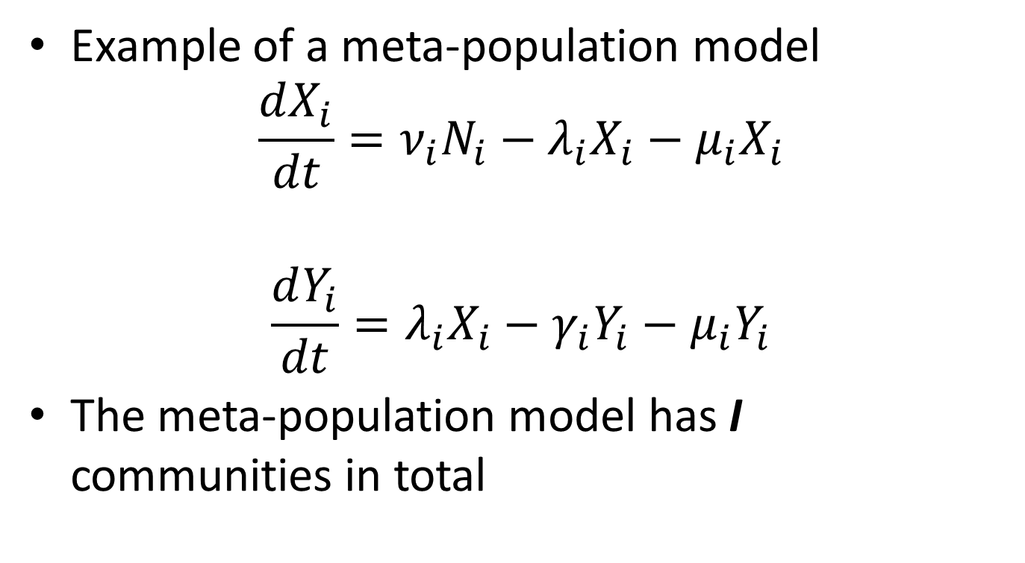
Meta-Populations
Example of a meta-population model
$$\frac{dX_{i}}{dt}=ν_{i}N_{i}−λ_{i}X_{i}−μ_{i}X_{i}$$
$$\frac{dY_{i}}{dt}=λ_{i}X_{i}−γ_{i}Y_{i}−μ_{i}Y_{i}$$
The meta-population model has I communities in total

Slide 18
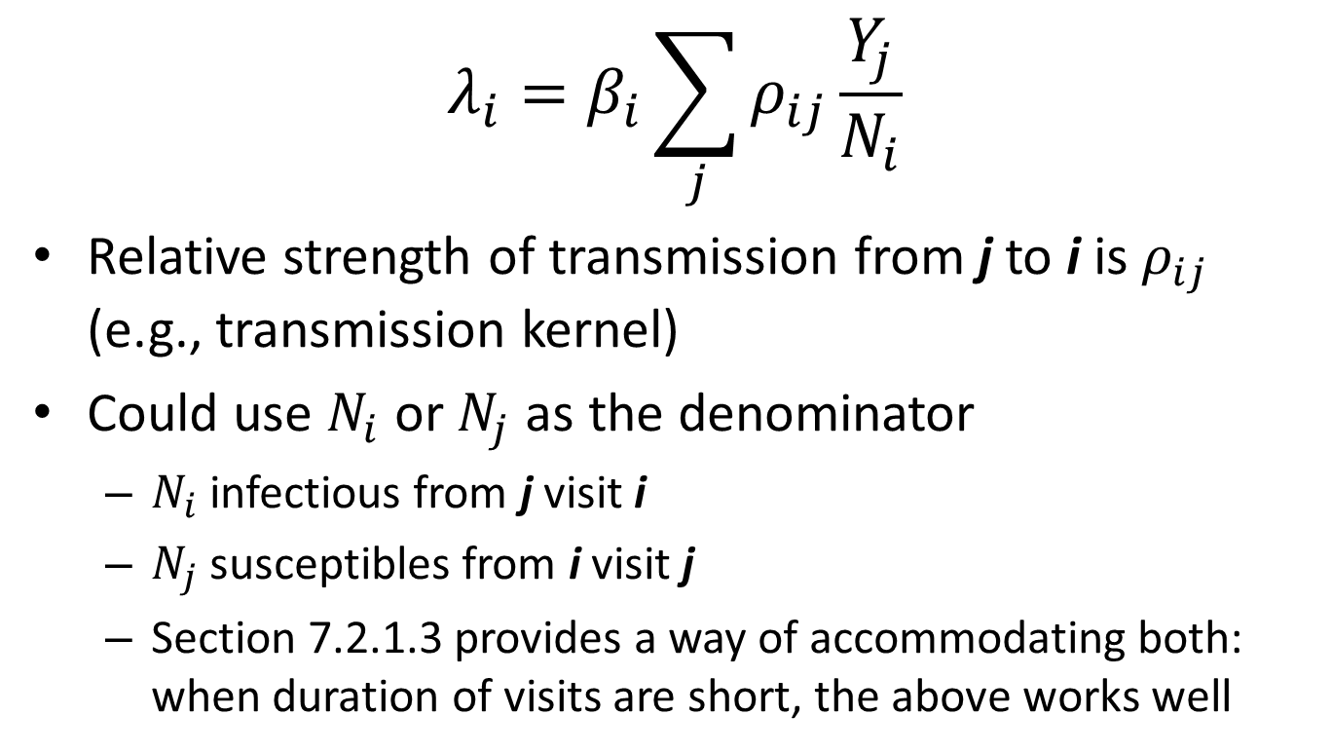
Meta-Populations: Forces of Infection
$$λ_{i}=β_{i}\sum_{j}{ρ_{ij}\frac{Y_{j}}{N_{i}}}$$
Relative strength of transmission from j to i is $ρ_{ij}$ (e.g., transmission kernel)
Could use $N_{i}$ or $N_{j}$ as the denominator
$N_{i}$ infectious from j visit i
$N_{j}$ susceptibles from i visit j
Section 7.2.1.3 provides a way of accommodating both: when duration of visits are short, the above works well
Book has typo and says Xj

Slide 19
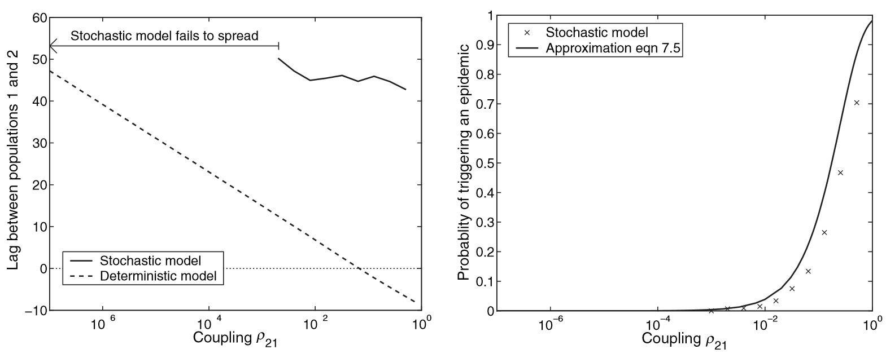

The function of $ρ_{ij}$ in Meta-Populations
The stronger $ρ_{21}$is the shorter the lag between an epidemic in i=1 and in j=2
The stronger $ρ_{21}$is the more likely an epidemic in i=1 triggers an epidemic in j=2

Slide 20
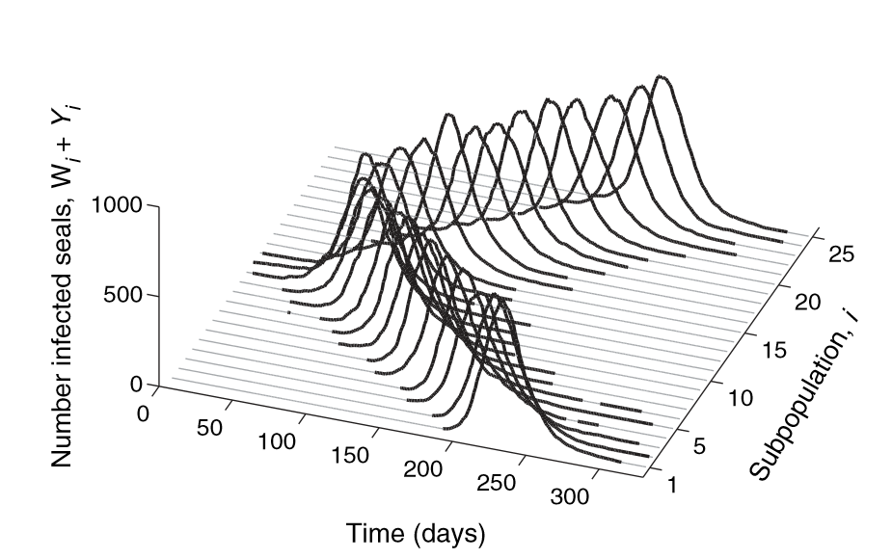
Lags and Asynchrony
By the time far communities are set off, first community is extinction (and could have reimportation)
Infection introduced
Nearby communities are set off
What would synchrony look like?

Slide 21
Shorter lags: greater synchrony
Since subpopulations in the meta-population are smaller, they have greater chances of local extinction
Coupling leads to reimportation which counters local extinction
Asynchrony of epidemic peaks (peak in one population lagging peaks in others) helps with reintroduction. Why?
Regular vaccination in a meta-population leads to reductions (risk of extinction) but also asynchrony. So will it be effective in causing global extinction?
Pulsed vaccination (synchronizing when vaccination is given across all subpopulations) may help to synchronize reductions to get global extinction

Slide 22
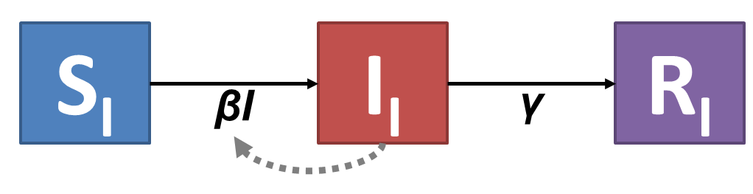
Lattice models (7.3 not assigned but good to know about)

Slide 23
Lattice models: Strength of kernel

Slide 24
Lattice models: Strength of kernel

Slide 25
Lattice models: Strength of kernel

Slide 26
Lattice models: It matters where you start

Slide 27


Like ripples in terms of timing and effect; with the potential for a lot of complexity

Slide 28
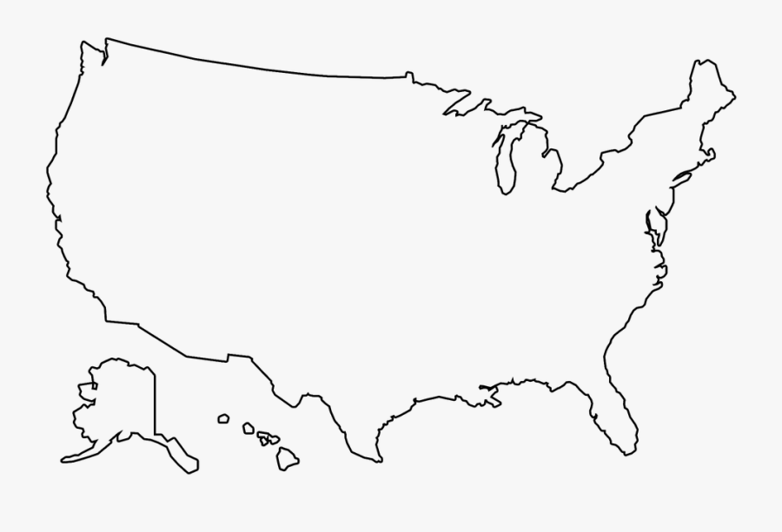
More complex versions: graphs of subpopulations
If line thickness between subpopulations is strength of coupling, how would you translate this into the modeling machinery we have built up today?

Slide 29
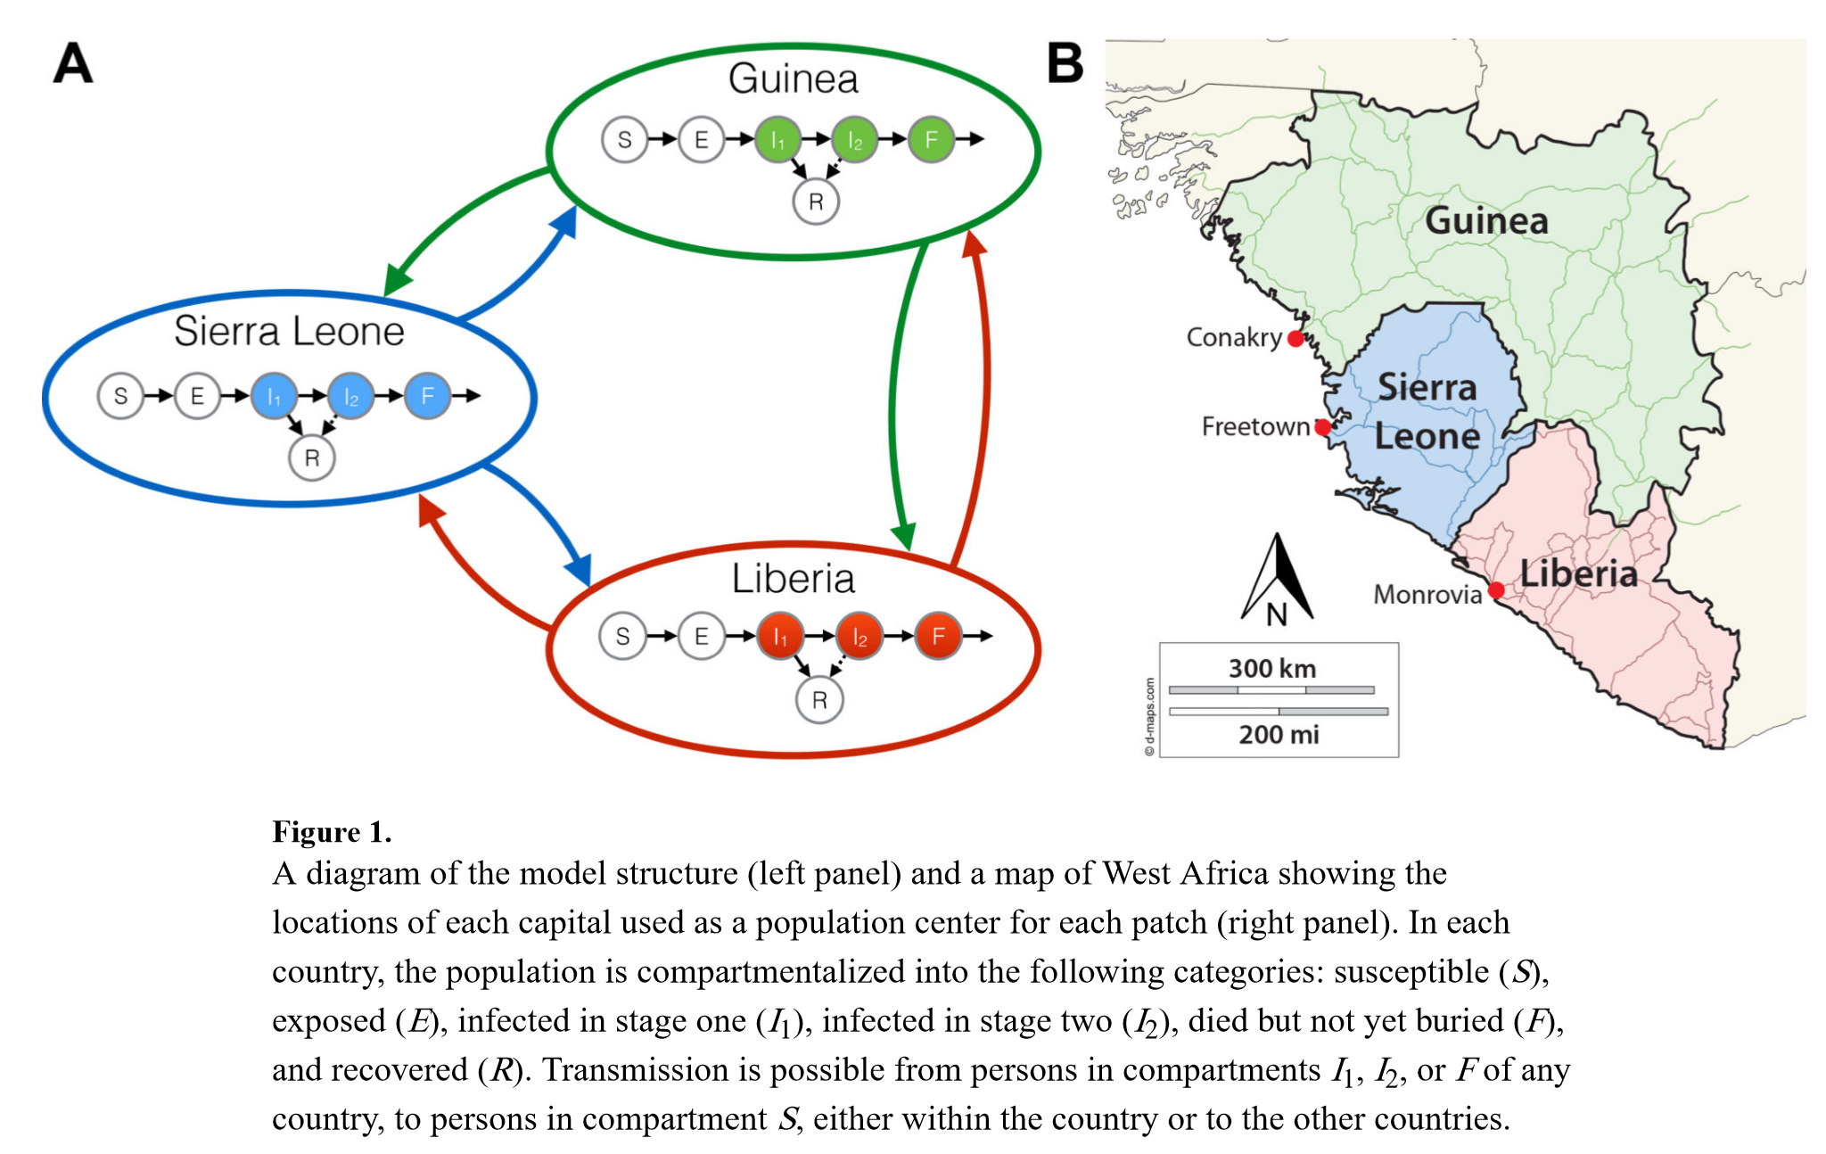
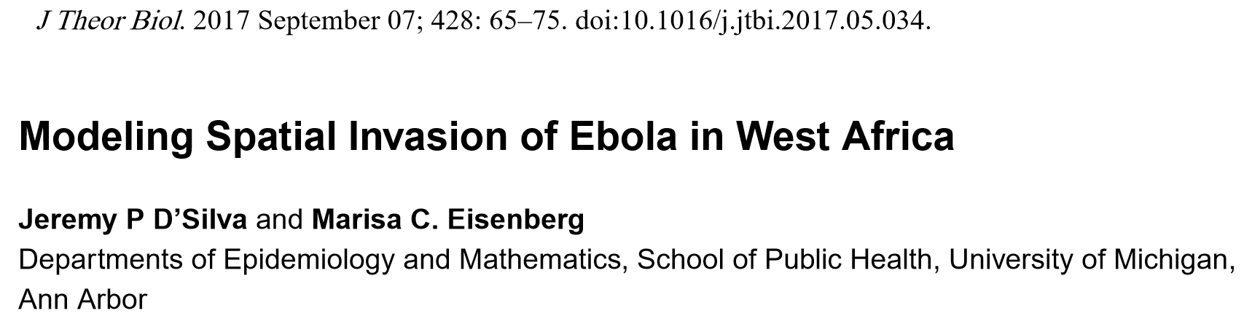

Slide 30
NETWORKS: INDIVIDUAL (STOCHASTIC) MODELS WITH EXPLICIT CONTACT STRUCTURES

Slide 31
A network is made up of nodes (people) and edges (connections over which transmission could occur)

Slide 32
Each person has a state (susceptible [white]; infectious [red]) at each point in time

Slide 33
Those who are susceptible are at risk of acquiring infection at the next time step if one of they are connected to 1 or more people who are infected
If this is time step t, who is at risk of infection at time step t+1?

Slide 34
Those who are susceptible are at risk of acquiring infection at the next time step if one of they are connected to 1 or more people who are infected
Who is at risk in time step t+1? And in time step t+2?

Slide 35
Typically one’s risk is higher if one is connected to more infectious people who could transmit to them
P(No infection) = [1-P(infect)]⁴

Slide 36
Connections via edges (and hence transmission risk) can also be dynamic
For these 3 people, what is the infection risk?
How about now?

Slide 37
In network models, risk of infection is local (heterogeneous), time-varying, and potentially dynamic
For these 3 people, what is the infection risk?
How about now?

Slide 38
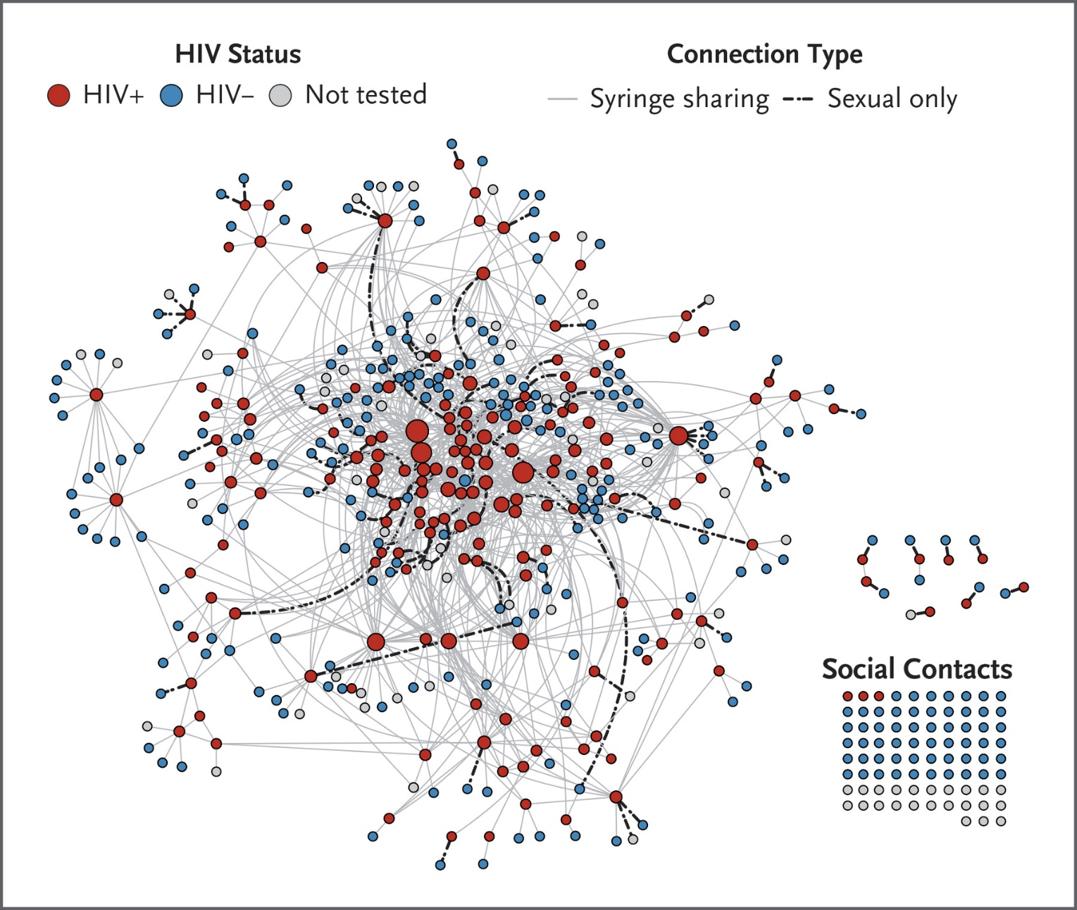
From micro-network structures to macro-network structures

Slide 39
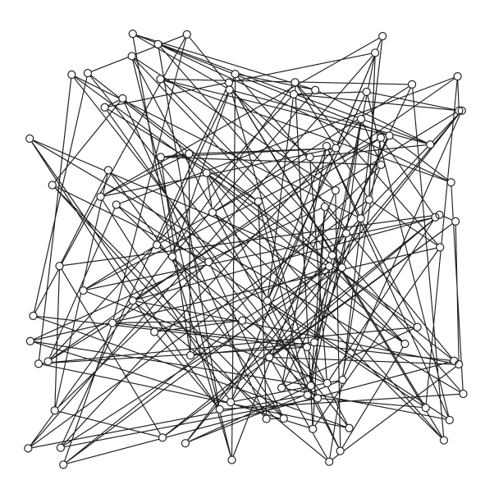
From micro-network structures to macro-network structures
Random
Each individual (row), is randomly assigned a 0 (not connected) or 1 (connected) for each other individual (column)
Another version gives everyone the same number of connections but randomly assigns pairing between individuals using up 1 connection for both of them
Path length is short because spatial structure ignored in forming connections
Initial growth rate in this network is
tau*(n_bar-2)
where tau = the transmission rate across a contact (edge) and n_bar is the average number contacts in the network have

Slide 40

From micro-network structures to macro-network structures
Lattice
Each individual (row), has the same number of edges and is only connected to those that are spatially (in the lattice-sense) adjacent to them
The average path length is very long
Spread through the lattice is slower on average than for the random network

Slide 41
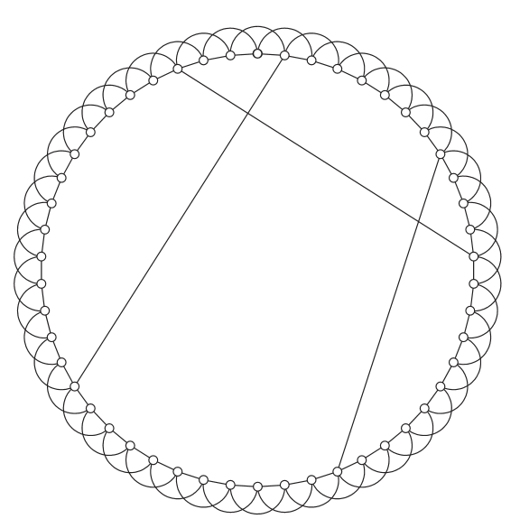
From micro-network structures to macro-network structures
Small World
Like the lattice but with a “few” long distance connections added.
Like lattice, saturation and propagating waves of infection occur, but the long-distance contacts accelerate diffusion throughout the network and are hence important to the timing and dynamics of the system

Slide 42
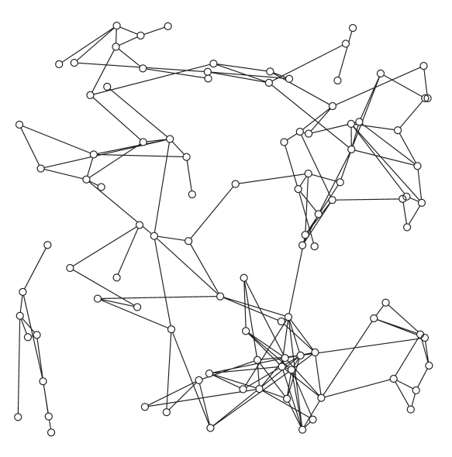
From micro-network structures to macro-network structures
Spatial
Likelihood of two individuals being connected is often related to a kernel, where distance means two individuals are (all else equal) less likely to be connected.
Changing the kernel and placement of individuals can lead to networks that are similar to lattices as well as to small world networks and to random networks as well (FLEXIBLE)

Slide 43
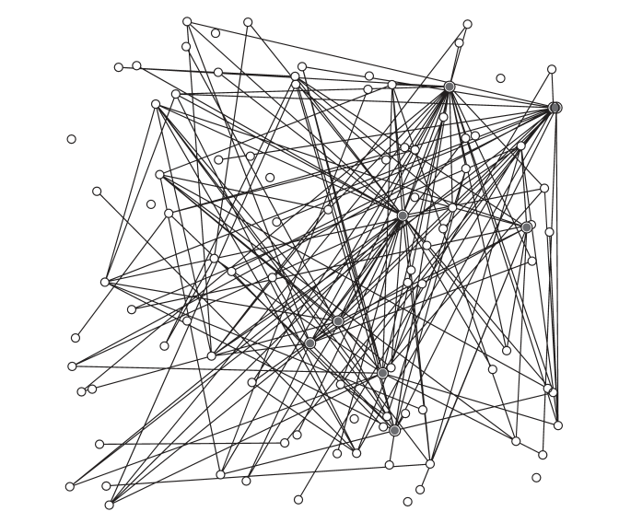
From micro-network structures to macro-network structures
Scale-Free
Empirical observation, real-world networks typically have most people with few contacts and a distribution on the number of contacts that appears to follow something like a power law. Scale-free networks incorporate the heterogeneities in the distribution of contacts.
They are also easy to dynamically update as new connections preferentially form with nodes that have many connections

Slide 44
Questions to ponder
When might we need a spatial model?
When all individuals do not mix randomly with all others (and tend to mix more with people close to them)
When populations separate naturally into distinct groups with much stronger within than between group interaction
When connected individuals are relatively low density and their connections are patchy (lots of little clusters connected to each other) and when many people have relatively few connections. What kinds of infections/transmission does this sound like?

Slide 45
Questions to ponder
How might interventions look in a network?
Vaccination? Treatment? Contact Tracing? Prevention?
Which interventions would be easier or harder to conceptualize in a network than in an SIR model?

Slide 46
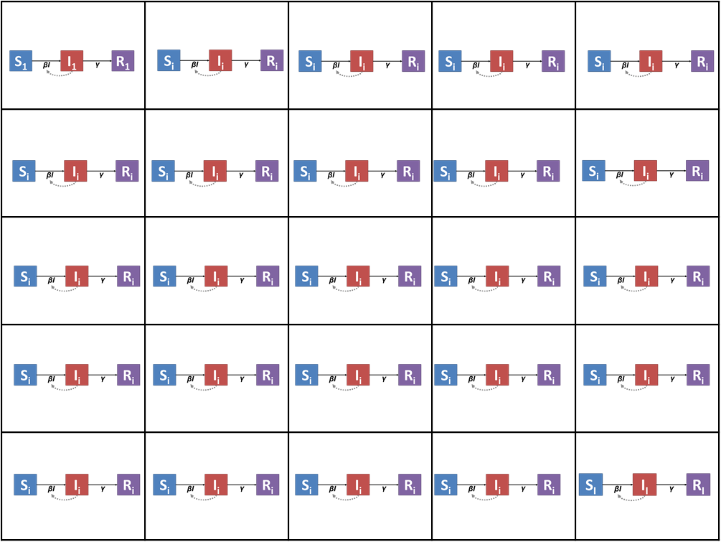
Questions to ponder
Can you imagine individual network models embedded in a lattice of meta-populations? Why would one do this?

Slide 47
Important Announcements

